Slide 1
HR Training Program:
Leadership Development || Delegation of Authority and Conflict Management
Training Details
FY | Training Date | Zone | No. of Participants
2026-27 | 17th July’2026 | North
2026-27 | September’2026 | South | -
2026-27 | November’2026 | West | -
Training Details:
This training on Delegation of Authority and Conflict Management equips individuals with practical skills to improve decision-making, build accountability, and enhance workplace collaboration.
Learning through real-life scenarios and interactive activities, participants will learn to clarify roles, delegate effectively, and manage conflicts to drive better team performance.
Key Points: (In Rs.)
The estimated budget for the North Zone training was ₹66,000. By conducting the training at PCP HQ, the entire budgeted cost was successfully saved.
A total of 18 participants attended the training against 22 nominations received. Based on the attendance, the projected income amounts to ₹53,100 (₹2950*18).
Training Highlights:
The HR Training was conducted for the first time in the North Zone on 17th July 2026.
The session received overwhelmingly positive feedback, with participants actively engaging throughout the training.
The training content and presentation materials were highly appreciated, and the overall design and appearance of the PPT were also well received.
South Training – Budget Details
The estimated budget for South Zone training is ₹44,000.
The expected participant count is 25 People.
Hence, the expected earning is ₹73570 (₹2950*25)
Note: HR Training for South Zone is tentatively planned for September

Slide 2
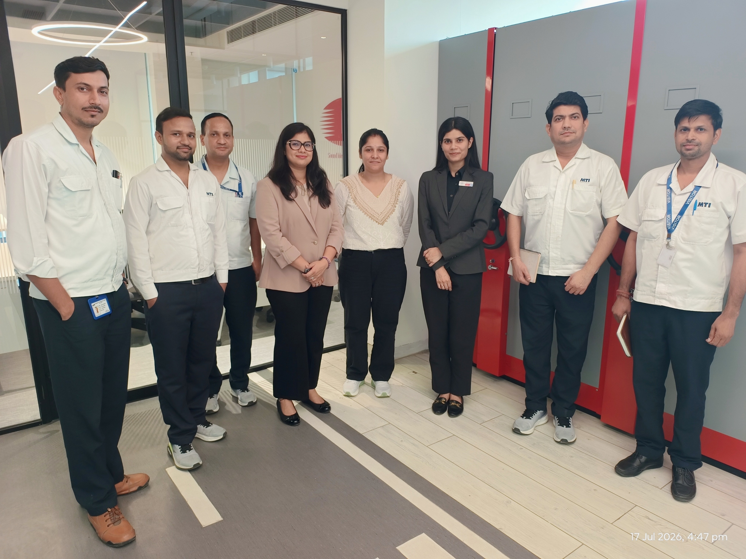
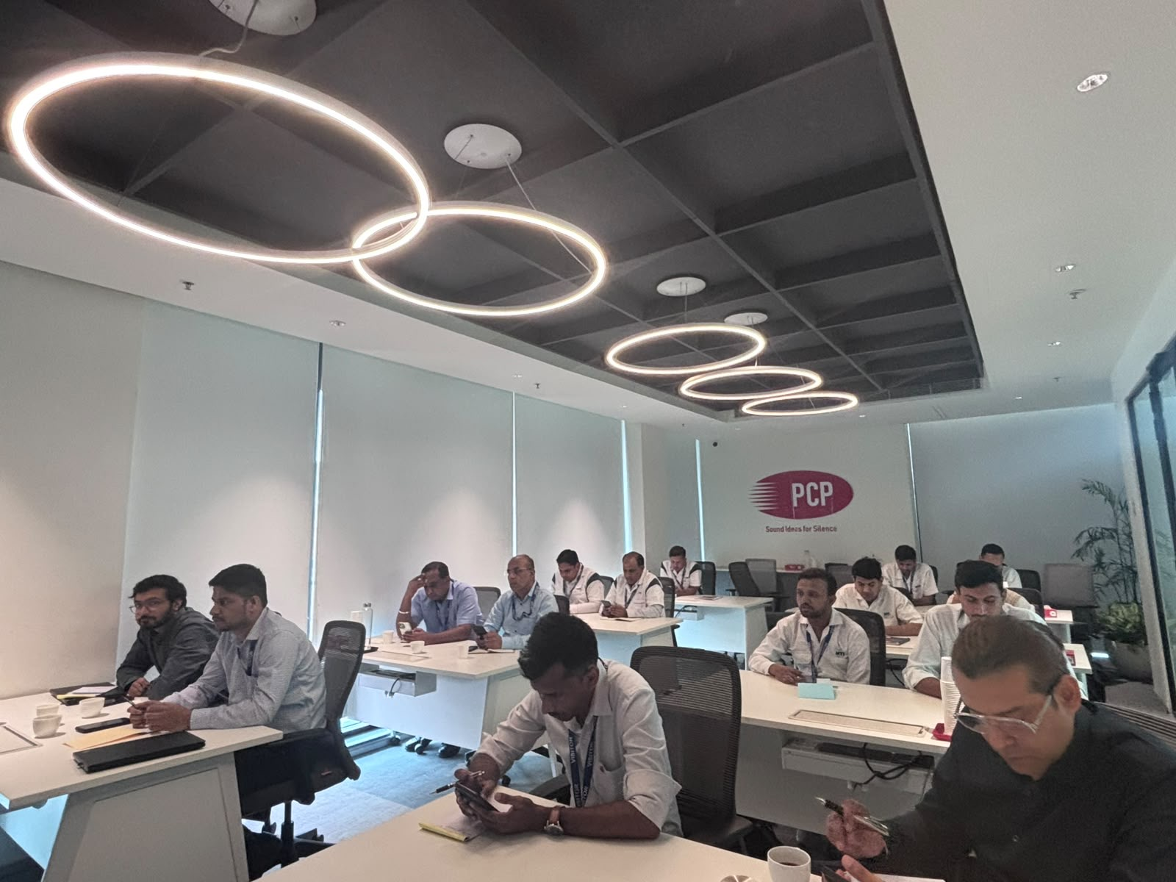
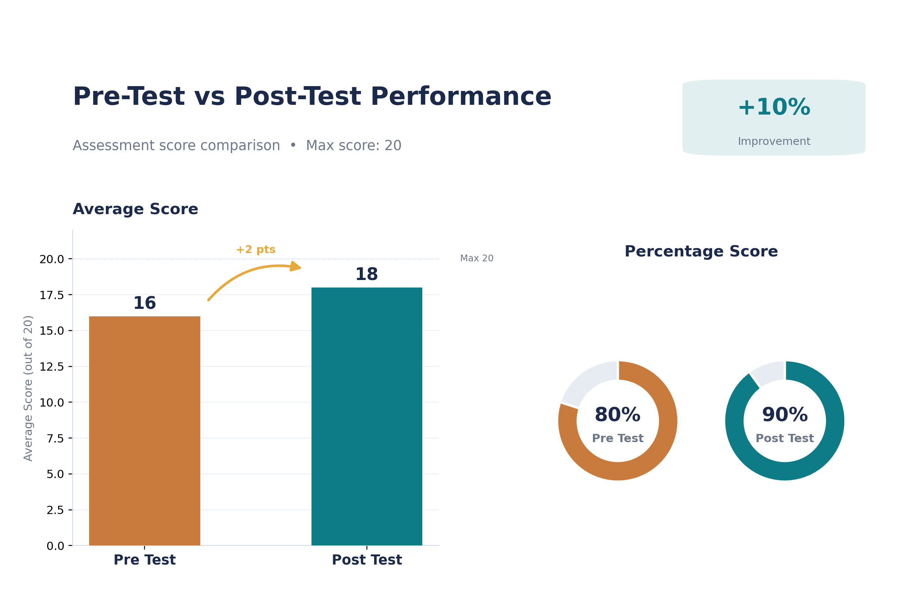
Activity Snapshot
Training Name:
Leadership Development| DOA and Conflict Management
Zone:
North Zone, July’26
Glimpse of Training Session
Training Feedback
Feedback
Feedback for Content
Participants found the modules on delegation of authority and conflict management highly relevant.
Content as well as the PPT was appreciated in reference to the looks as well as being crisp
Some Real scenarios (Case Studies were demanded).
People demanded a training on “ Power of Positive words and Positive Mindset”
Pre – Post Test Analysis
Feedback for Trainer
The trainer’s strong presentation skills and hands-on activities were highly appreciated by participants.
The trainer’s engaging and interactive delivery fostered a dynamic learning environment.
Participants expressed satisfaction with both the content and the topics covered during the session.

